Slide 1



EXCAVATE
TEAM NAME : DATA HACKERS

Slide 2

CONTENT
Problem statement
01
02
Data Visualisation
03
Data Preprocessing
04
Models Selection
Use in Sustainability Measures

Slide 3

PROBLEM STATEMENT
01
To Investigate intrinsic parameters to understand and predict glass-forming ability, specified in the material's critical casting diameter (Dmax).
02
03
04
05
Analyze the dataset provided
Incorporating new features to the dataset
06
07
08

Slide 4




Data Visuallization
Next Page

Slide 5
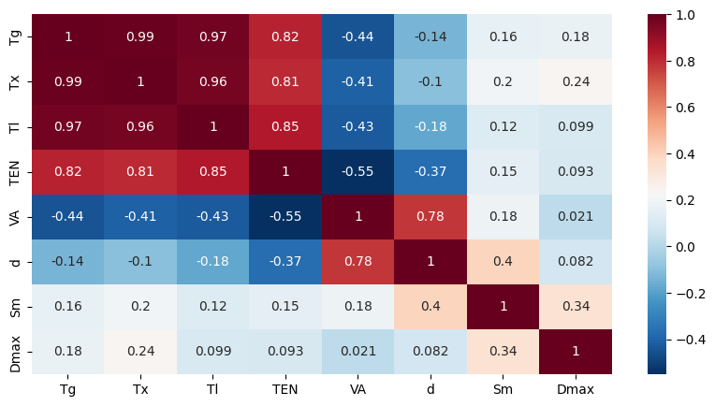
CORRELATION PLOT OF GIVEN SET OF FEATURES
Next Page

Slide 6
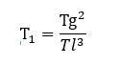
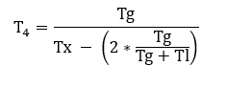
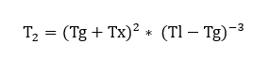
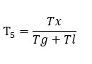
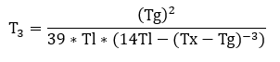
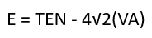
FEATURE EXTRACTION
https://www.sciencedirect.com/science/article/abs/pii/S0927025621002196
https://pubs.rsc.org/en/content/articlehtml/2021/sc/d0sc06675c
Next Page

Slide 7
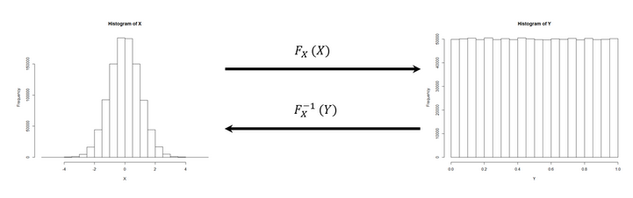
DATA PREPROCESSING
QUANTILE TRANSFORMER
Quantile transformation is a statistical technique used to transform a variable so that its probability distribution matches that of a chosen reference distribution, typically a uniform or normal distribution.
It scales down every feature to (0,1)

Slide 8
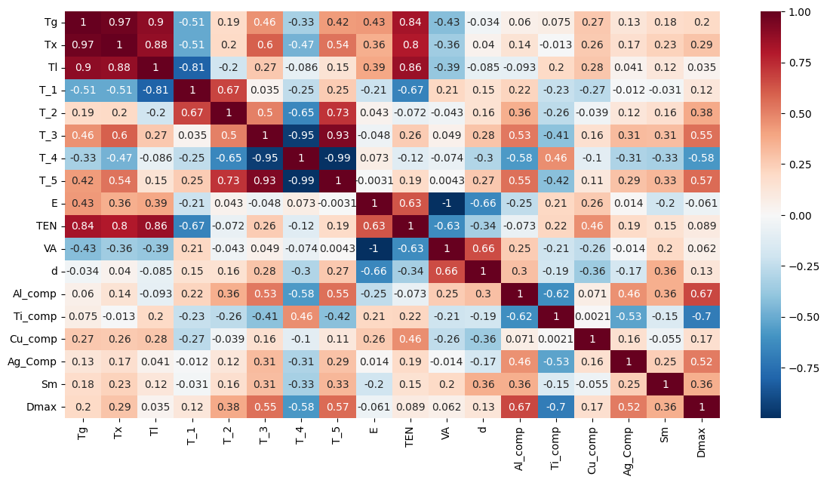
CORRELATION PLOT OF NEW SET OF FEATURES
Next Page

Slide 9
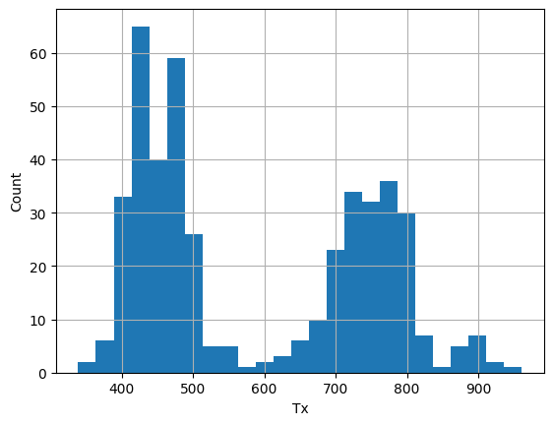
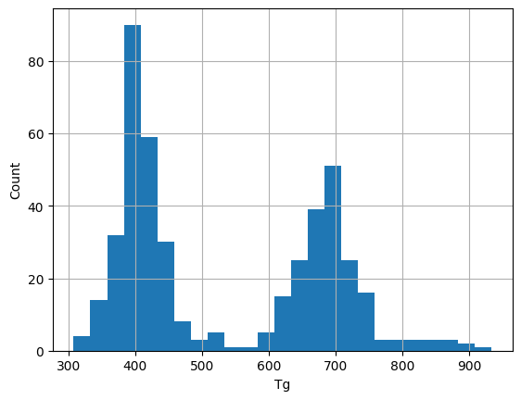
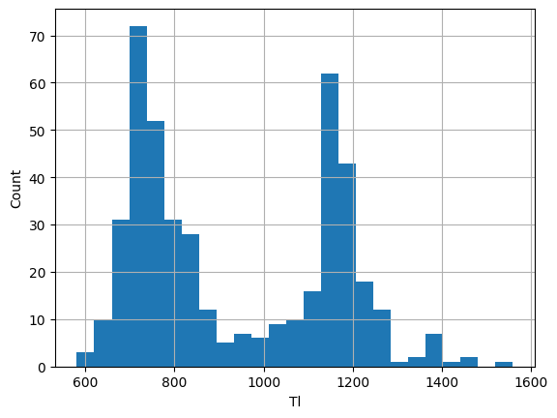
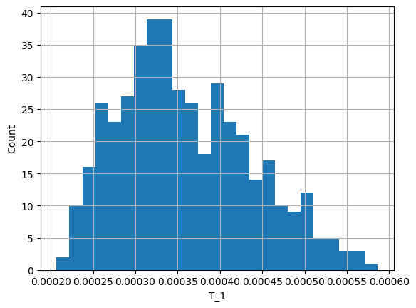
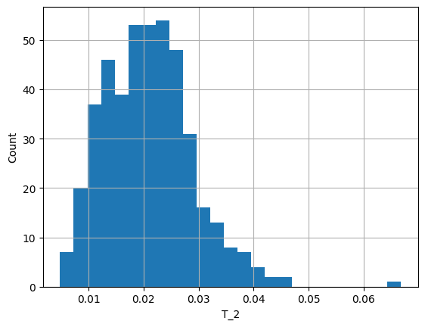
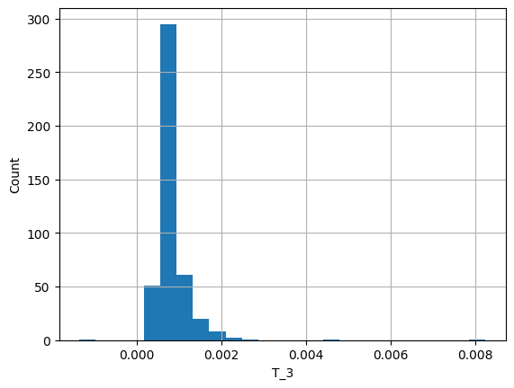
HISTOGRAM PLOT OF DISTRIBUTIONS OF THE FEATURES
Next Page

Slide 10
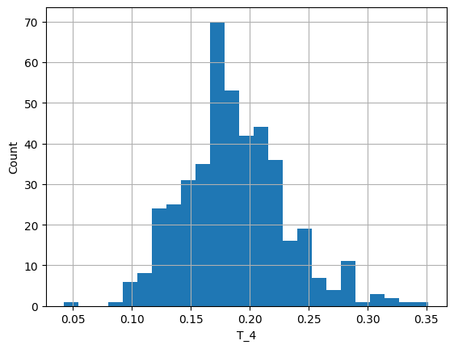
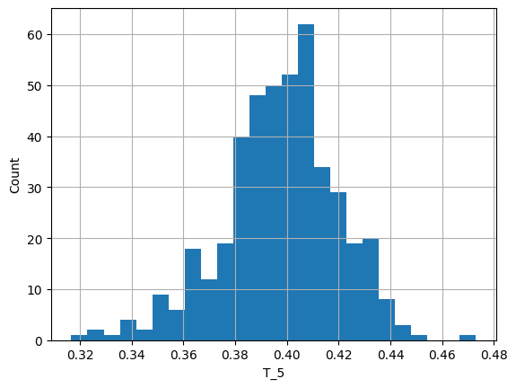
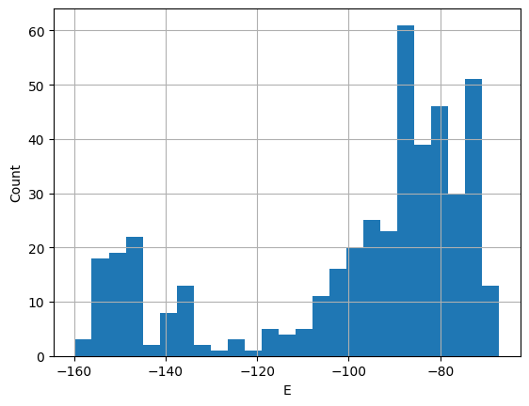
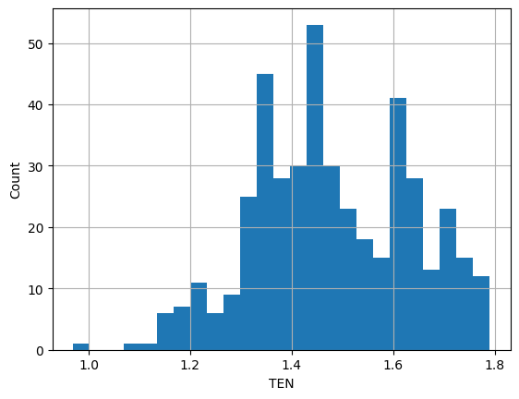
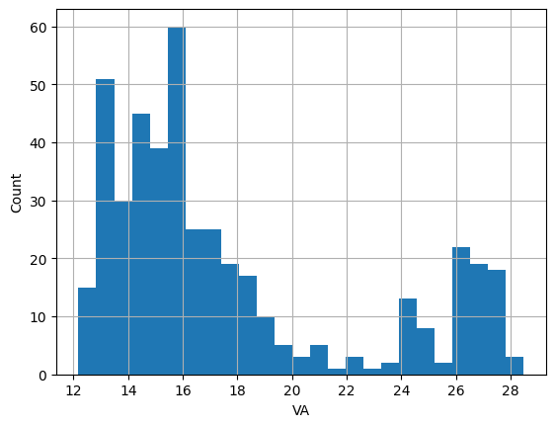
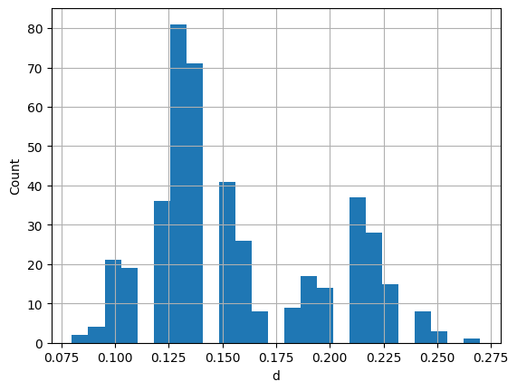
HISTOGRAM PLOT OF DISTRIBUTIONS OF THE FEATURES
Next Page

Slide 11
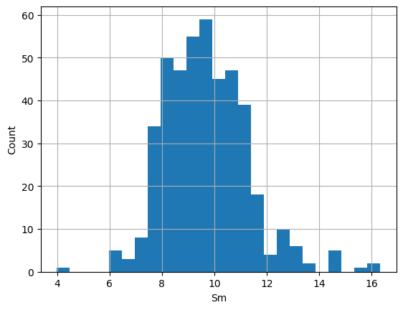
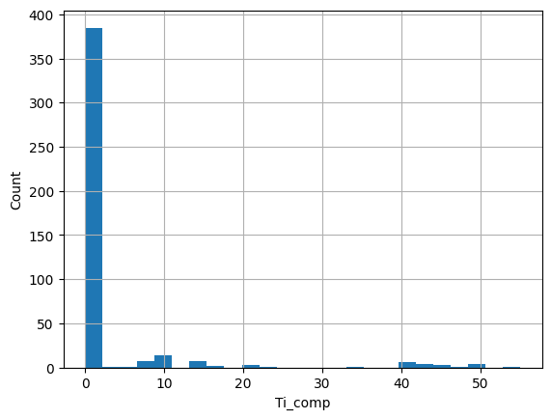
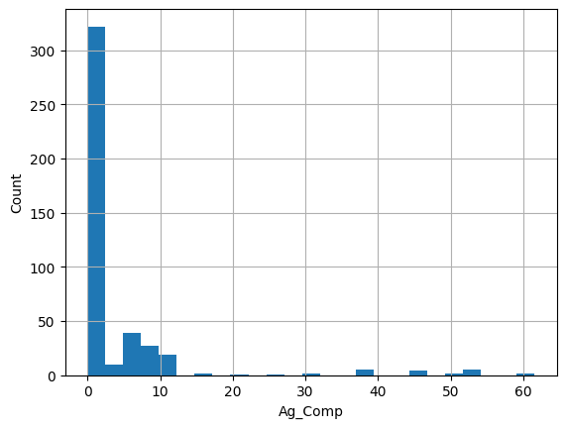
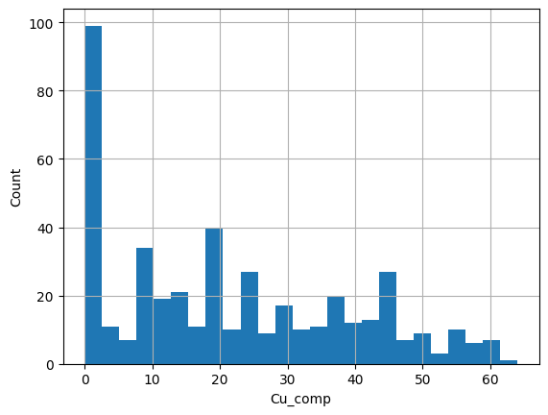
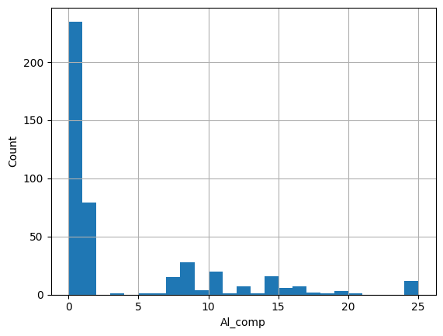
HISTOGRAM PLOT OF DISTRIBUTIONS OF THE FEATURES
Next Page

Slide 12
MODEL SELECTION
Types of Regression models used:-
Random Forest
Gradient boosting
XGBoost
01
Extra Tree Regression
Multilayer Perceptron
Stacking Ensemble Model
02

Slide 13
PREDICTION ACCURACY TESTS
TESTS -
01
Average of R2_scores
02
Standard Deviation of R2_Scores

Slide 14
RESULTS
METHOD | Average of R2 Score | Standard deviation of R2 Score
Random Forest | 0.7877307 | 1.11022 * 10^(-16)
Gradient Boosting | 0.7984139 | 0.0041452
Stacking Ensemble | 0.8140747 | 0.0193195
XGBoost | 0.8444288 | 0.0
MLP | 0.8581349 | 0.0053796
Extra Trees Regressor | 0.8669322 | 0.0

Slide 15


USES IN SUSTAINABILITY MEASURES
Highly recyclable. This reduces the need for raw materials
https://www.ifc.org/en/insights-reports/2021/strengthening-sustainability-in-the-glass-industry
Production methods are energy efficient
resulting in reducing energy consumption and associated greenhouse gas emissions.
https://www.researchgate.net/publication/273146021_Sustainable_Manufacturing_Process_for_Bulk_Metallic_Glasses_Production_Using_Rapid_Solidification_with_Melt_Spinning_Technique
Excellent strength-to-weight ratio. Stronger than many conventional metals while being significantly lighter leading to reduced fuel consumption and emissions thus having applications in consumer electronics and transportation
https://www.sciencedirect.com/science/article/pii/S0079642524000525

